Slide 1
Orientation meeting
Welcome at your new home!
Fachschaft Chemie of the University of Cologne
Math-Nat / Chemie / Fachschaft | Orientierungseinheit | Rose Jordan | 27.10.2020

Slide 2
Who should be here?
Chemistry
Bachelor of Science
Bachelor of Arts (Lehramt)
Biochemistry
Bachelor of Science
New Master students
Volunteers for today

Slide 3
…and who is actually here?
Please put in front of your Zoom name:
Chemistry Bachelor: BSc
Chemistry Education: BA
Biochemistry Bachelor: BC
Chemistry Master: MSc
It should look like this: xxx-[your name]

Slide 4
…and who is actually here?
Were gonna play a little ask game now to find out! ☺

Slide 5
What does the Fachschaft do?
Councils to improve the study courses
Tutoring groups
Social events (e.g. Semester trips)
Old exam material for studying
Books
Helping students whereever possible
Kicker table (ab 16 Uhr)
Drinks

Slide 6
Who is part of the Fachschaft?
Fachschaftsrat (Fachschaft council)
elected student representatives
Tutors (for Bachelor)
Active volunteers
Everyone can help! Just ask us to come by a meeting sometime ☺
All chemistry students

Slide 7
Der Fachschaftsrat
(The Fachschaft council)
5 representatives, elected yearly
connect students with professors
student representatives in committees
ready to answer your questions via mail or at the Fachschaft office during opening hours

Slide 8
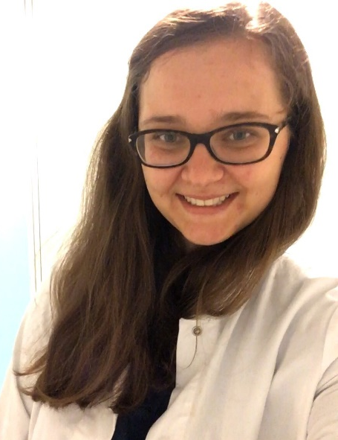
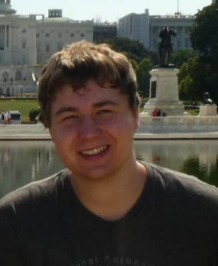
Der Fachschaftsrat
Kathi
Nils
Rose
Milena
Nora

Slide 9
Drinks – sadly not during corona!
Kölsch 0,5 L 1,20€
Pils 0,33 L 1,00€
Softdrink 0,33L 1,00€
Wasser 0,7 L 0,50€
Tasse Kaffee 0,30€
Wassereis 0,10€
KEIN BIER VOR VIER Zwölf!
(außer nach Prüfungen)

Slide 10
Tutor groups for the first semesters
for first three semesters:
general chemistry
inorganic chemistry
organic chemistry
theoretical chemistry
physical chemistry
physics
help with chemistry questions
test exams
times of tutor classes: see fs-chemie.uni-koeln.de/tutorium

Slide 11
Contact
Opening hours: See plan at Fachschaft and online
Meetings: Thursdays at 7 pm, via Zoom at the moment
(Dates can change, please ask beforehand to make sure)
Website: www.fs-chemie.uni-koeln.de
Email: fs-chemie@uni-koeln.de
Phone: 0221-470-4415
Facebook: facebook.com/chemiefachschaft/
Instagram: instagram.com/fs.chemie.koeln/

Slide 12
Contact to the Fachschaften of other departments
Fachschaft Biology
another contact point for biochemistry students, know about biology-related stuff
Mail: fs-bio@uni-koeln.de
Facebook: https://www.facebook.com/fsbiokoeln/

Slide 13
Contact to the Fachschaften of other departments
Fachschaft Chemiedidaktik (chemistry didactics)
Contact point for people studying or interested in chemistry for teaching
Mail: fachschaft-chemiedidaktik@uni-koeln.de
Facebook: https://www.facebook.com/chemiedidaktikfachschaft

Slide 14
Lab courses
Usually 1-6 pm
at uni building
Mandatory attendance (especially for the safety instructions!)
Antestat (test before experiments, mostly in bachelor courses) and lab journal/protocols
Single- or partner work

Slide 15
Lab insurance
Insurance for accidents in the lab (including people getting hurt)
12 or 18 € per semester (simple/advanced insurance)
max. 50 € paid by yourself
http://www.chemie.uni-koeln.de/evaluation0.html

Slide 16
Lockers
In the basement of the chemistry departments
Register at the Fachschaft
Renew each year except during corona closing times
not renewed lockers will be emptied (we‘ll tell you before)
How to get a locker?
pick open, empty locker and put a lock on it
remember the locker number
register with your name and the number at the Fachschaft
No food can be stored in a locker with lab equipment!

Slide 17
Lockers and Corona
Getting a locker is not possible before the corona measures end and we can go back to uni as usual
until then alternatives for storing your stuff will be offered for your lab courses

Slide 18
Chemistry library
reference library offering chemistry books
work stations where you can work quietly (!)
noise insulated seminar rooms with projectors for study groups etc
closed at the moment because of corona

Slide 19
CIP-Pool
room with computers for community use
sign in with smail account
printing and scanning
many licensed programs

Slide 20
Studium Integrale (SI)
Expanding your horizon:
extracurricular modules
internships (1 week = 1 CP)
signatures for attending talks at the institutes
different courses, e.g. Green Chemistry, Naturstoffe, Kolloquienlaufzettel…
one exam at the Math-Nat faculty needs to be passed but the grade is irrelevant
Similar for master: S-Module

Slide 21
Important People
Examination offices
B.Sc. Chemistry: Mrs. Groth-Lüdtke, HS 117
B.A. Chemistry: Mrs. Danitz, HS 118
B.Sc. Biochemistry: Mrs. Groth-Lüdtke, HS 117
M.Sc. Chemistry: Mrs. Danitz, HS 118
Study course coordinators
B.Sc. Chemistry: Prof. Ruschewitz
B.A. Chemistry: Dr. von der Gönna
B.Sc. Biochemistry: Prof. Niefind
M.Sc. Chemistry: Prof. Giernoth

Slide 22
Kölner Studierendenwerk
Student housing
Mensa (lunch/cafeteria)
Psychological counseling
Law advice
BAföG (financial support for students)
http://www.kstw.de/
InfoPoint at Universitätsstraße 16

Slide 23
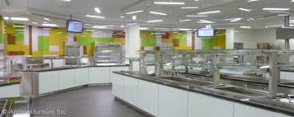
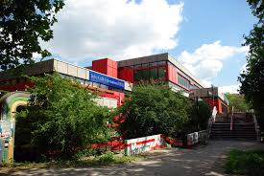
Food - Mensa
UniMensa at Zülpicher Straße
Menu online
pay using Mensa card

Slide 24
Important stuff on the Internet
KLIPS2
https://klips2.uni-koeln.de/
Register for modules and exams
ILIAS
https://www.ilias.uni-koeln.de/
Platform for teaching material
Webmail
https://webmail.uni-koeln.de/
Uni mail address
Internetseite des Departments
https://chemie.uni-koeln.de/
Time tables, exam dates etc

Slide 25
What you need for semester start
student ID card „UC-Card“ (Mensa, library, public transport ticket…)
Lab protective gear (VWR-Laden Wait for notice from lab coordinators!)
Lab coat
Lab goggles
Acid protection gloves
Basic equipment (VWR see above!)
Lab insurance
Register for modules via Klips

Slide 26
Dates
More Fachschaft events:
28.10.: Rallye on campus and around cologne – groups will be assigned at the end of this meeting!
29.10.: Digital Pubquiz – groups will be assigned at the end of this meeting!
Scholarship info meeting 10.11. 4 pm
Safety instruction meeting for lab courses (don‘t miss!)
Registry deadline for physics lab (bachelor)
Begin of lab courses (s. KLIPS2)
Christmas: Feuerzangenbowle (hopefully)
January: Test exam general chemistry

Slide 27
Questions?
And afterwards: socializing in smaller groups! ☺

